Slide 2
Engineering Foundations An overview
Tony Nicol

Slide 3
Engineering Foundations Hardware overview

Slide 4


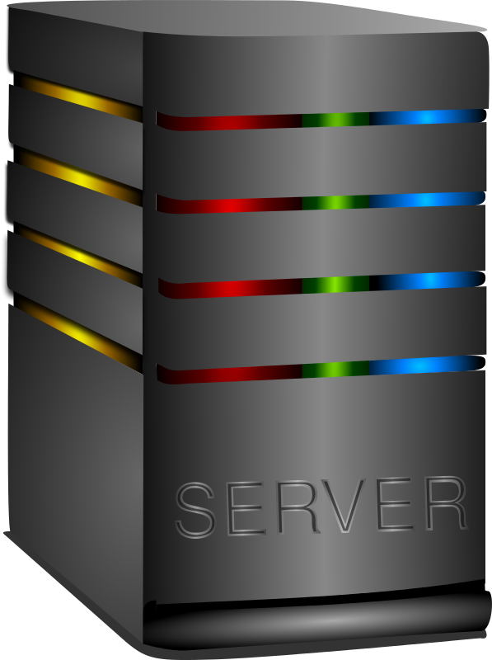
Web-based systems
UK User
Internet
US User
Azure, AWS, Google, Oracle Cloud Services, on-prem
German User
Australian user
Physical or
Virtual Machine
Notes:
We have a front-end UI and a back-end in a data centre to run the service and connect to it via the internet
This is fundamentally the same approach to any web-based application such as a shopping site. You request information, carry out actions, update data
We need hardware and software to implement this - in this session I'll focus on hardware and first

Slide 5
Hardware: Basic Architecture
Hardware: physical components of a computer system including
Input Devices: Examples include keyboard, mouse, scanner
Output Devices: Examples include monitor, printer, speakers
Primary storage (RAM, ROM/Flash)
Secondary storage (Hard Disk Drives (HDD), Solid State Drive (SSD)
Processing Unit
CPU (Central Processing Unit)
GPU (Graphics Processing Unit)
Motherboard: Connects all components together
Power Supply: Provides electricity to the system
Servers are a little different in that they have less stuff but are more powerful
RAM
ROM/
Flash
CPU
Drive
Input
Output
Network

Slide 6
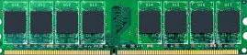
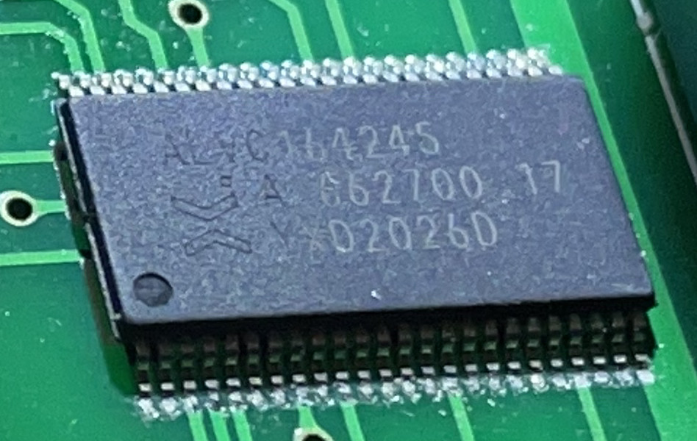
Basic Primary Storage
RAM
Random Access Memory (RAM)
Extremely fast ~50GB/s R & W
Capacity typically ~32GB
Volatile
Holds code & data during execution
Randomly addressable from CPU
Flash Memory
Slower ~10MB/s read, ~2MB/s write
Capacity typically ~ 16MB
Non-volatile
Popular for firmware
Randomly addressable from CPU
ROM/
Flash
CPU
Drive
Input
Output
Network

Slide 7
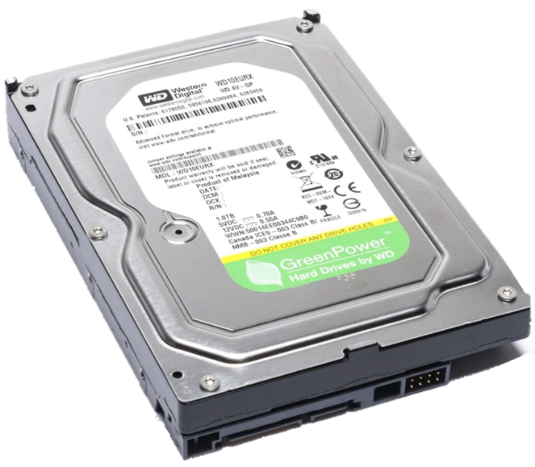
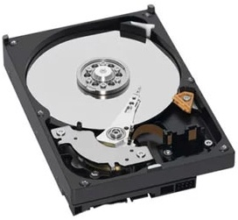
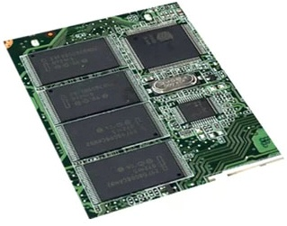
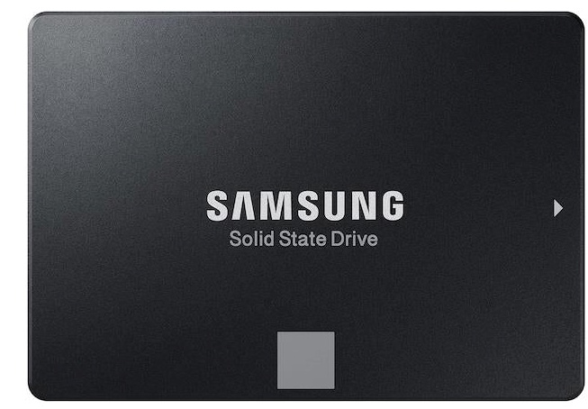
Basic Secondary Storage
Hard Disk Drive
Spinning magnetic disk
Huge storage ~tens of TB
Sequential access ~100MB/s
Random I/O < 500 IOPS (very slow)
Input Output oPerations per Second
Limited reliability as Mechanical
Non-volatile
Holds data longer than SSD with no power
Popular for archive or cost
Solid State
No moving parts
Large storage can be tens of TB but expensive
Sequential access ~500MB/s
Random access ~ 1.5 Million IOPS (MIOPS)
More reliable than HDD
Non-volatile
Shock proof

Slide 8
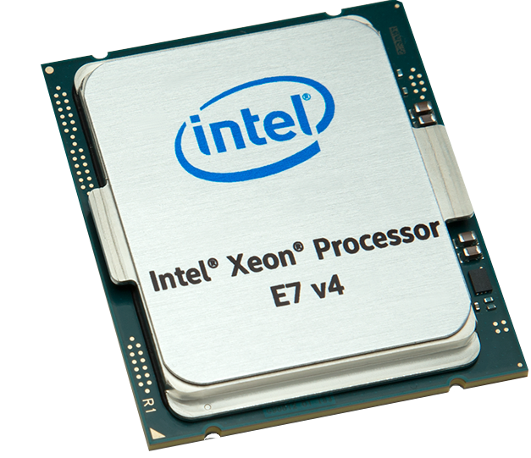
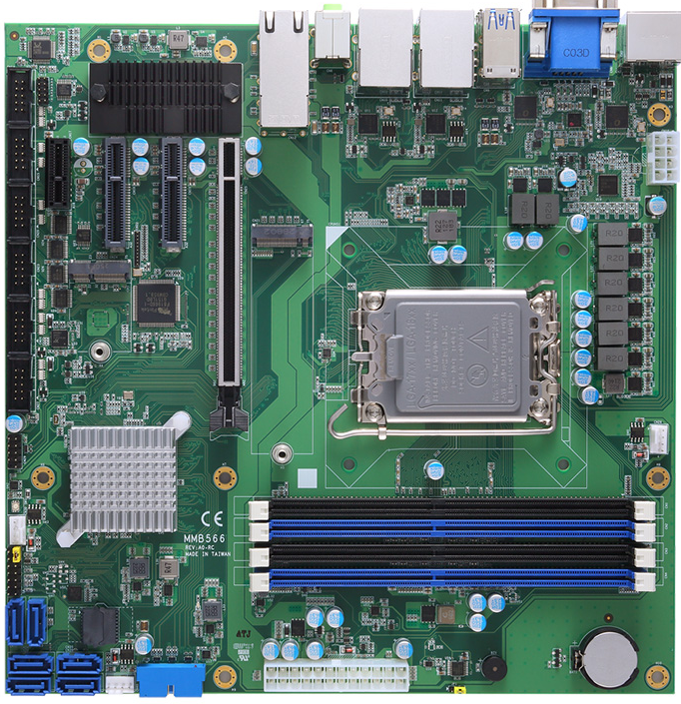
Central Processing Unit
RAM
CPU accesses RAM via address
Reads and decodes instruction
Execute instruction - e.g. add 2 numbers
Store result in RAM
It is a binary machine - only operates with 1 and 0
Motherboard
Connects all the bits together
ROM/
Flash
CPU
Drive
Input
Output
Network

Slide 9
Engineering Foundations Number Systems

Slide 10

Number Systems
Positional number system can be written: Where p is the largest positive power (leftmost digit), m is number of fractional digits
For a decimal system, R (radix or base) is 10, Coefficient C is 0 to 9, p largest int digit, m largest fractional digit
So, 10552.75, p=4, m=2 = 2x10⁰+5x10¹+5x10²+0x10³+1x10⁴+7x10⁻¹+5x10⁻²
1x10⁴+0x10³+5x10²+5x10¹+2x10⁰+7x10⁻¹+5x10⁻²
10552.75 = 10000 +500 + 50 + 2 + 0.7 + 0.05
So, for binary numbers, R=2, C=0 to 1
10010010.101 = 1x2⁷+0x2⁶+0x2⁵+1x2⁴+0x2³+0x2²+1x2¹+0x2⁰+1x2⁻¹+0x2⁻²+1x2⁻³
10010010.101 = 128+0+0+16+0+0+2+0.5+0+0.125 = 146.625₁₀
Binary numbers are awkward to work with, so we often use a related base of 16 - hexadecimal
So, for hexadecimal numbers, R=16, C=0 to F so a hexadecimal number of
2A3F.AB = 2x16³+Ax16²+3x16¹+Fx16⁰+Ax16⁻¹+Bx16⁻²
2A3F.AB = 8192+2560+48+15+0.625+ 0.04296875 = 10815.66796875
What about the octal value 2345.67
Notes:
convert the octal value 2345.67₈ into decimal
Octal digits represent powers of 8:
2\times 8^3=2\times 512=1024
3\times 8^2=3\times 64=192
4\times 8^1=4\times 8=32
5\times 8^0=5\times 1=5
Integer total:
1024+192+32+5=1253
Fractional
6/8+7/64 = 0.859375
2345.67₈ = 1253.859375₁₀

Slide 11
We regularly convert from hexadecimal to binary and visa versa. Fortunately, that's easy
Work in groups of 4 bits there is a direct mapping
Binary Dec Hex 0 0 0 0 0 0 0 0 0 1 1 1 0 0 1 0 2 2 0 0 1 1 3 3 0 1 0 0 4 4 0 1 0 1 5 5 0 1 1 0 6 6 0 1 1 1 7 7 1 0 0 0 8 8 1 0 0 1 9 9 1 0 1 0 10 A 1 0 1 1 11 B 1 1 0 0 12 C 1 1 0 1 13 D 1 1 1 0 14 E 1 1 1 1 15 F

Slide 12
Engineering Foundations Operating System Basics

Slide 13
Operating System Basics
A series of programs responsible for providing services to users, managing memory, interacting with hardware
Popular: Windows, Linux, MacOS, Android, iOS
Key components
Kernel - the core of the OS
Process management: create schedule and terminate processes (programs), allocates CPU time / multi-tasking
Memory Management: allocates RAM to programs, protect areas of RAM from interference between processes
File system management: organise data on drives, read / write file, manages dirs, access control, permissions
I/O management: manages data in and out between software and hardware - e.g. files, printers, keyboard, screen etc
Device drivers: low level interface of specific hardware converting OS requests to hardware specific instructions
Security and protection: authentication, authorisation, access control to files and processes
Networking: implements coms protocols including tcp/ip, udp, dns - enables sending and receiving data across network
Other OS elements
User interface (CLI/GUI): Windows cmd shell, powershell, Linux bash. Create desktop
System utilities: System support tools such as file explorer, backup tools, IPconfig, ping, system restore - lots of stuff

Slide 14
Office
Email
Game
Web Browser
Explorer
User Apps in RAM
Operating System (Windows, Mac OS X, Linux)
System Apps in RAM
Disk
Printer
Keyboard
Screen
Hardware devices
The Operating System is the go-between for software and hardware
Say toy are writing a word dock. As you press a key, the operating system sees the character and sends it to the word processor. The word processor writes the character in RAM.
e.g., Office word is told to save a file, it tells the OS to redraw the window to reflect the change to its content given you have just typed a character. The OS instructs the graphics card to draw the window as a block of pixels on the screen made up of RGBA or red, green, blue and alpha making up a 32 bit number for each pixel
R=255 is full red. etc
A=0 is fully transparent - background shows, no pixel value. 255 is opaque. 128 gives 50% transparent

Slide 15
As the operating system is a load of files on a disk, how does it get loaded into RAM to be executed?
When the system is started, the CPU is set to point to a specific memory location for start-up code
Startup firmware code in the Flash memory. Used to be BIOS in Windows but most now use UEFI
Unified Extensible Firmware Interface (UEFI). The code checks the system health (Power On Self Test - POST) and provided enough functionality to read a small chunk of the OS from a drive into RAM. It then executes that code which accesses the drive and loads the rest of the OS in and starts the desktop and authentication code
RAM
ROM/
Flash
CPU
Drive
Input
Output
Network

Slide 16
Fetch / Execute
X
F
10110111
Y
E
00011100
D
00000000
Process of Y=X+Y
Output address 0
R=1 so read 11100011. Instruction = get X
Inc prog counter (PC) to 1 and read 00001111
Output 00001111 on address bus
Read value of X from location F = 10110111
Go back to PC address and increment
Read from location 2 - "read Y" instruction
Increment PC to read Y address 00001110
Increment PC and read next instruction "Add"
Execute add 10110111 + 00011100
Increment PC (5) to read destination address
result 11010011 set write to 1
Output 1110 (E) to address bus to access Y
Write 11010011 to Y (address E)
C
10101010
B
11111111
A
11001100
Data
9
10101010
8
11100011
7
10000000
R/W
6
10101010
CPU
Save
5
00001110
Add
4
11000110
Addr Y
3
00001110
Read Y
2
00000011
Addr X
1
00001111
Read X
0
11100011
Address
1
1
0
1

Slide 17
Real code for y=x+y
Real assembly language and machine code for the previous example: y=x+y where x=7, y=5
00000000 07000000 x DWORD 7 00000004 05000000 y DWORD 5 00000000 A100000000 mov eax, [x] ; eax = data at address 00000000 (0) 00000005 030504000000 add eax, [y] ; eax = x + data at address 04000000 (4) 0000000B A304000000 mov [y], eax ; write to address 04000000 (4), x + y
x86 architecture uses Little-endian byte order
DWORD is 4 bytes or 32 bits
Instructions are variable length. In this case the instructions are:
A1 - mov into eax value from address
03 - add to, 05 - eax register the value at the address, in this case 4 or y
A3 - mov into memory location eax
High level language such as C, C++, Java
int x=7, y=5; y=x+y;
Notes:
uasm64.exe /c /Fl /Sa ./asmsrc/demo.asm

Slide 18
Parallel processing: When several programs can be run at the same time, independently
Uses multiple CPUs. Like opening more checkouts when there is a queue
A CPU used to have one processing core on the chip. Modern CPUs have multiple cores
We can now parallel process within a single CPU
Laptop 2-16 cores, server CPU up to 192 cores (Intel Diamond Rapids, AMD EPYC Turin Dense))
Process: process is a running program. It is allocated memory and executing instructions
OS keeps track by issuing each process with a process ID
Multitasking: run multiple processes at the same time. Like a single fast checkout operator
OS runs one process for a few millisecond, then another, then another etc, then back to the first
User thinks all processes are running at the same time
Chrome browser tabs are independent processes hence fast and stable but greedy on RAM
If a CPU has 16 cores, Chrome (and other apps) can allocate each tab to a core to get parallel processing

Slide 19
Threading: the spawning of sub-processes. i.e. running different parts of the program at the same time
e.g. Word is a process. Opening a second window on the doc is a thread - it looks like they are both running
Multiple users accessing the same program at the same time
It is executing different parts of the program concurrently
e.g., A lengthy process in one thread and UI in another - user need to wait for or even notice lengthy process
threads emulate parallel processing by multi-tasking within the same application (process)
CPU multithreading: e.g. 2 threads. CPU can fetch instructions from two areas of RAM
The core is shared by the two pipelines providing the OS with what looks like 2 cores
As the core has only one execution engine, the performance isn't doubled, more like 15-35% increase
So, for an 8 core CPU with hardware multithreading, the OS sees 16 CPUs
2 CPU threads is typical (AMD, Intel) as the returns diminish quickly with more

Slide 20
Software overview
Software is an intangible element of computing, unlike hardware which is tangible - i.e. you can touch it
Software is made up of computer programs and data
A computer program is a sequence of precise logical instructions
It is written using a specific syntax, i.e. rules of the language
Spoken & written language has syntax: start with a capital, end with a full stop, put words in order of meaning
Programming is more precise, break one syntax rule and your code probably won't run
Where does software live and what does it look like?
Typically stored in files on a drive but could be in Flash memory such as firmware
Program is read from disk into RAM for the CPU to execute
CPU only executes machine code which is very granular and in binary
We can write code in machine code, but it is a slow, tedious and error-prone process
We generally write code in a high-level language, nearer English, then convert to machine code for execution

Slide 21
Code translation
Interpreter
The interpreter is a program that converts source code into machine code - like a language interpreter
One line of source code is converted to machine code then executed
Next line is converted and executed etc.
Benefit is mainly that you can quickly test code as you write it. Add another line, run the program
Runs on any system with the interpreter installed
Generally slower execution than a compiled language
Examples include Python, JavaScript, PHP, Ruby, Basic …
Source code is distributed so everyone can see the detail of how your code works and maybe copy it
Compiler
Translates whole program into machine code and saves it in a file
Tends to execute much faster as all the machine code is available, no need to continually translate during runtime
Compiler has a holistic view of the whole program so can optimise the machine code better
Deployed code is the machine code file (e.g. .exe) so source code (readable stuff) is not deployed
Machine code will only execute on a machine that understands that particular code
Examples include C, C++, Java, Rust …

Slide 22
Engineering Foundations Virtual Machine and Cloud Hosting Introduction

Slide 23
Virtual Machines
A virtual machine is a software emulation of a physical machine hence the name virtual machine
A hypervisor (software) allocate and ring-fence physical resources
A physical machine can host multiple virtual machines which to the user, look just like multiple physical machine and although there is some performance overhead, virtual machines are now very mature and performant
There is a type 1 hypervisor, typically used on a remote server in a data centre. The hypervisor runs directly on the hardware so is referred to as a "bare metal" hypervisor.
A type 2 hypervisor is used when you already have an operating system installed - e.g. on a client machine
The hypervisor runs on top of the OS and asks the OS to allocate resources
e.g. A Win 11 laptop with a type 2 hypervisor such as Oracle VirtualBox or VMware. These need installing
Win 11 also has a type 1 hypervisor called HyperV. When this is enabled, it becomes the bare metal hypervisor and Windows is relegated to being a VM

Slide 24
App1
App2
Appn
App1
App2
Appn
App1
App2
Appn
App1
App2
Appn
App1
App2
Appn
App1
App2
Appn
App1
App2
Appn
App1
App2
Appn
VM
Linux
Ubuntu
VM
Win
Server
VM
Linux
Centos
VM
Win 11
VM
Linux
Ubuntu
VM
Win
Server
VM
Linux
Centos
VM
Win 11
Hypervisor Type 2 (e.g. Virtual Box, VMWare workstation)
Hypervisor Type 1 (e.g. ESXi, Hyper-V, Xen)
Host OS (e.g. Windows, Ubuntu, MacOS)
Physical machine
Physical machine
Key difference here is the hypervisor type and the presence of lack of a host operating system
A VM is an isolated whole machine with its whole operating system and applications – like individual servers or PCs. They are isolated at the hypervisor level when using a type1 hypervisor or by the host OS for type 2
Because of the size of some of the operating systems it can take minutes to load and start
Because VMs are software, they can be cloned quickly
For VMware workstation: .vmx is the vm confign (RAM, CPUs, NICs, display etc), vmdk is the disk, .nvram is the BIOS/UEFI virtual chip, autoinst.iso, like a cd - loads tools into the OS
Vmware demo
Notes:
D:\VMs\Vmware\ubuntu22
Show creation of a new one using windows iso on D
Kill it when up to language
Show ubuntu and windows working as vms
Shut ubuntu down - copy files and install second VM
Show all 3 and win 11 al working together and reference the diagram

Slide 25

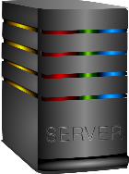

Client - server
Bolton Agent
Azure, AWS, Google, Oracle Cloud Services, on-prem
Preston Agent
Physical or
Virtual Machine
London Agent
We need our app to be deployed remotely so others around the world can access it

Slide 26
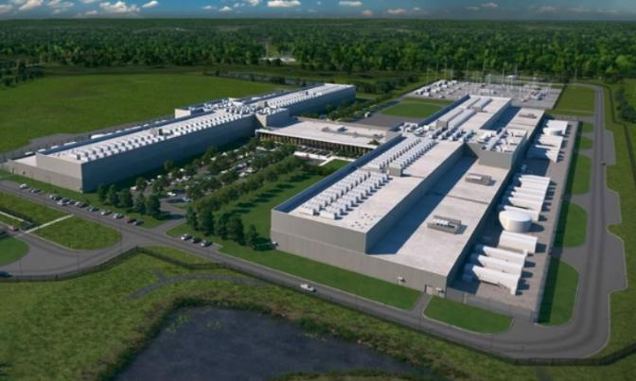
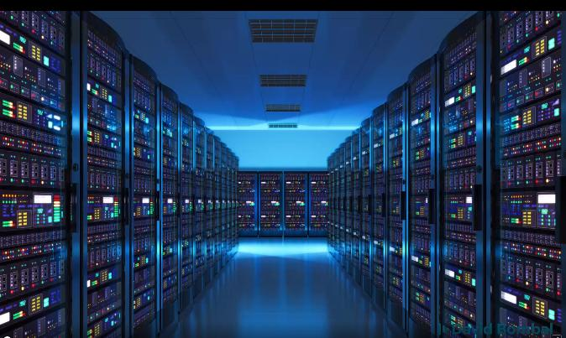
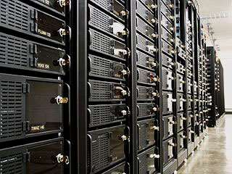
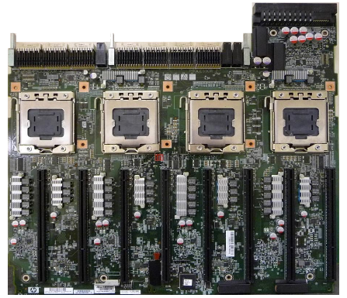
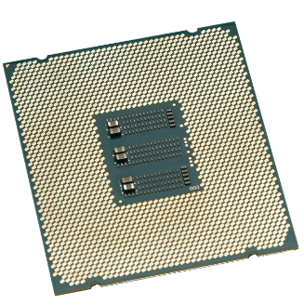
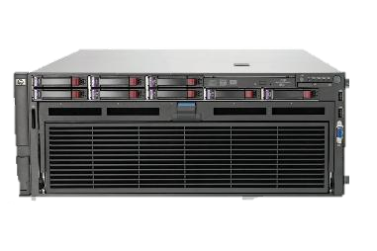

What does "the cloud" & "on-prem" look like?
Intel Xeon up to 56 CPU per chip, motherboard up to 448 vCPU
Notes:
Explain that on-prem is the same as cloud except for asset ownership
We are moving to avoid cap-ex and enable elasticity and pass some of the responsibility for buying and setting to work the servers and networking to the cloud provider
We need less infrastructure experts and no need t pay for hardware refresh every 4-5 years
Cloud hosts provide many services including databases, storage, etc Many services low level services, the ones we will cover work pretty much the same in all cloud environments but many are proprietary so are not transferrable across cloud providers so we are said to suffer vendor lock-in. On the other hand, proprietary services are designed to work well together as the are designed by the same company – e.g. powerBI and Microsoft fabric.

Slide 27
Virtual Machines
It would be very inconvenient for the cloud provider if we wanted to rent 10 physical servers one day then reduce to 5 the next day. Having to re-route networking and security – pulling cables and plugging them in elsewhere is infeasible – but possible (and is one model)
You may find that the extremely powerful physical machines are too big for your application and you can’t get the most out of them and a whole machine is expensive
Businesses want to be able to scale their infrastructure regularly so a software approach to infrastructure architecture is required so the cloud providers can allocate machines that have been released, for immediate use for someone else
A virtual machine is a software emulation of a physical machine hence the name virtual machine
A physical machine can host multiple virtual machines which to the user, look just like a physical machine and although there is some performance overhead, virtual machines are now very mature and performant

Slide 28

What are: Virtual Machine, Public Cloud, IaaS?
Tesco
Infra Eng
Hypervisor
Asda
Infra Eng
HSBC
Infra Eng
6 CPU
128GB RAM
1CPU
16GB
RAM
3 CPU
64
GB
RAM
2 CPU
32
GB
RAM
Infrastructure engineers send commands to allocate a portion of the physical server as a virtual server - this is IaaS
Choose how much RAM
How many CPU
3 different orgs, different size VM
Hypervisor ensures isolation of each
Install an operating system on each one
DevOps Engineer deploy application to it
Users can login and use the application
Demo: create a VM
https://azure.microsoft.com/en-us/Free
https://aws.amazon.com/free
Notes:
DOn't want to have to pay for 448 vCPUs when we only need 1 or 2
lswh
lsb_release -a

Slide 29
Cloud Business Model
For an enterprise, you need a lot of compute and storage. You need premises with strong physical security, redundant power, high speed networking, racks of servers with redundant power and network cards, lots of storage for files and databases, infrastructure security and the list goes on. All this comes as a sunk cost referred to as Capital Expenditure. You pay for it then the assets depreciate over time, about 5 years. You need specialised staff to install, protect and maintain all this equipment
If you want to scale your application, i.e. give it more CPU or Storage, you need to buy and install more stuff which can take a long time. Once you have scaled up, if the traffic for your service reduces, you are stuck with a load of kit that’s hardly being used
Amazon found themselves in this position and at times had a lot of spare capacity so why not rent it out? At least until you need it back. That idea grew into what we have today where the data centres are specifically used to rent these services
This means businesses can replace CapEx with OpEx – i.e. operating costs which are service costs rather than depreciable asset costs. The rental model is basically pay for what you use. If you want more then pay more. If you want to scale down then do so and pay less
The cost and hiring difficulties and permeant salary costs of many specialist staff required to maintain and operate the infrastructure moves to cloud service provider so this is seen as a good business model
Businesses are able to capitalise on economies of scale

Slide 30
Virtual machines are just files. You use the hypervisor to allocate resources then install the OS as if it was a new machine. You then use it to write and run your programs like you would on a physical machine. You install tools and apps into it – e.g. Visual Studio, MS Office or whatever. It all gets lumped into on file
As the vm is effectively just a file, it can be copied. You may want to create one with just the OS and core apps then clone it. If you have problems with virus or whatever, you can delete the vm and start the clone up in a couple of minutes with the OS and apps already installed
If you use the vm approach in your back-end, in a data centre or on the cloud, then if you need to scale, you just clone what you have, start the new vm and use both to handle traffic – use 10 or whatever. We will get scaling later
To take this a step further, if the hardware monitoring of the physical machine indicates that a failure is likely, the vms can be automatically moved to a different physical server – by copying as they are only files, then restarted on the new hardware
Demo: vm on azure
Notes:
Azure or AWS - both do more or less the same things in the same ways. I'll not use both to avoid confusion. Azure is best for managing the free account

Slide 31
Main Cloud Computing Types
Private cloud
Can be on-prem to provide complete control of infrastructure
Can be in the cloud but completely private from others. No one else shares your physical servers
Better security and privacy. Hosted in your own data centre or private managed servers so you maintain control of sensitive data and maintain data sovereignty
Downside: all admin is provided by the customer
Public cloud
Share infrastructure with unknown others – relies on good security configuration for segregation
Costs less as when you switch something off, someone else can use that resource
Access from anywhere in the world
Security and privacy is more complex and important to get right
Hybrid
Some systems on prem and some in the cloud
Maybe for security - or as part of a phased migration – or to keep sensitive data on prem
Applications and data can span both
Much more complex

Slide 32
Cloud Service Models
IaaS: Infrastructure as a service – you deploy and manage architecture, operating system, apps, databases etc
Basically rent servers / memory / disk and related power, networking etc
Fast server scaling
No ownership of hardware
Most control but also need more skilled staff such as architects, network specialists, dev-ops, maintenance team
PaaS: Platform as a Service
IaaS plus OS, tools, database etc. You just need to create and deploy the apps onto it and it will scale for you
No need to worry about OS licenses, patching, upgrades etc.
Less skilled resources needed – once architected, only need mainly developers. All patching etc is part of the service
SaaS: Software as a Service
Infrastructure, resilience, scaling, DR, elasticity etc is a managed service and so is the software and licenses
Examples include: O365, SAP applications, Seibel CRM etc
Unlike desktop apps, you can access SaaS applications from anywhere with any device that can access the internet
DBaaS: Database as a service - full service between PaaS and SaaS in the cloud - e.g. MongoDB Atlas

Slide 33
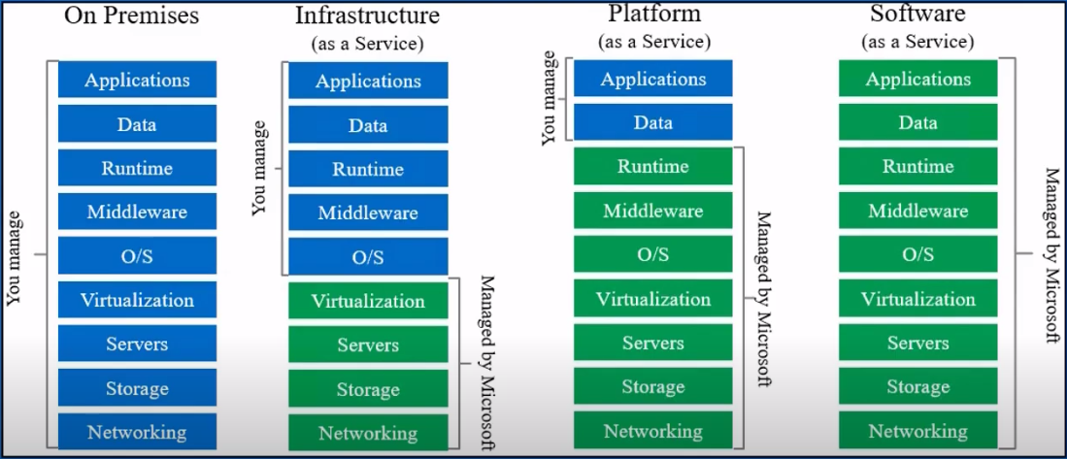
Cloud Model Responsibilities

